Slide 1
0.set a range for movement
bending: 9, 8.5, 8,... cm
twisting: 0, 30, 60, 90,

Slide 2
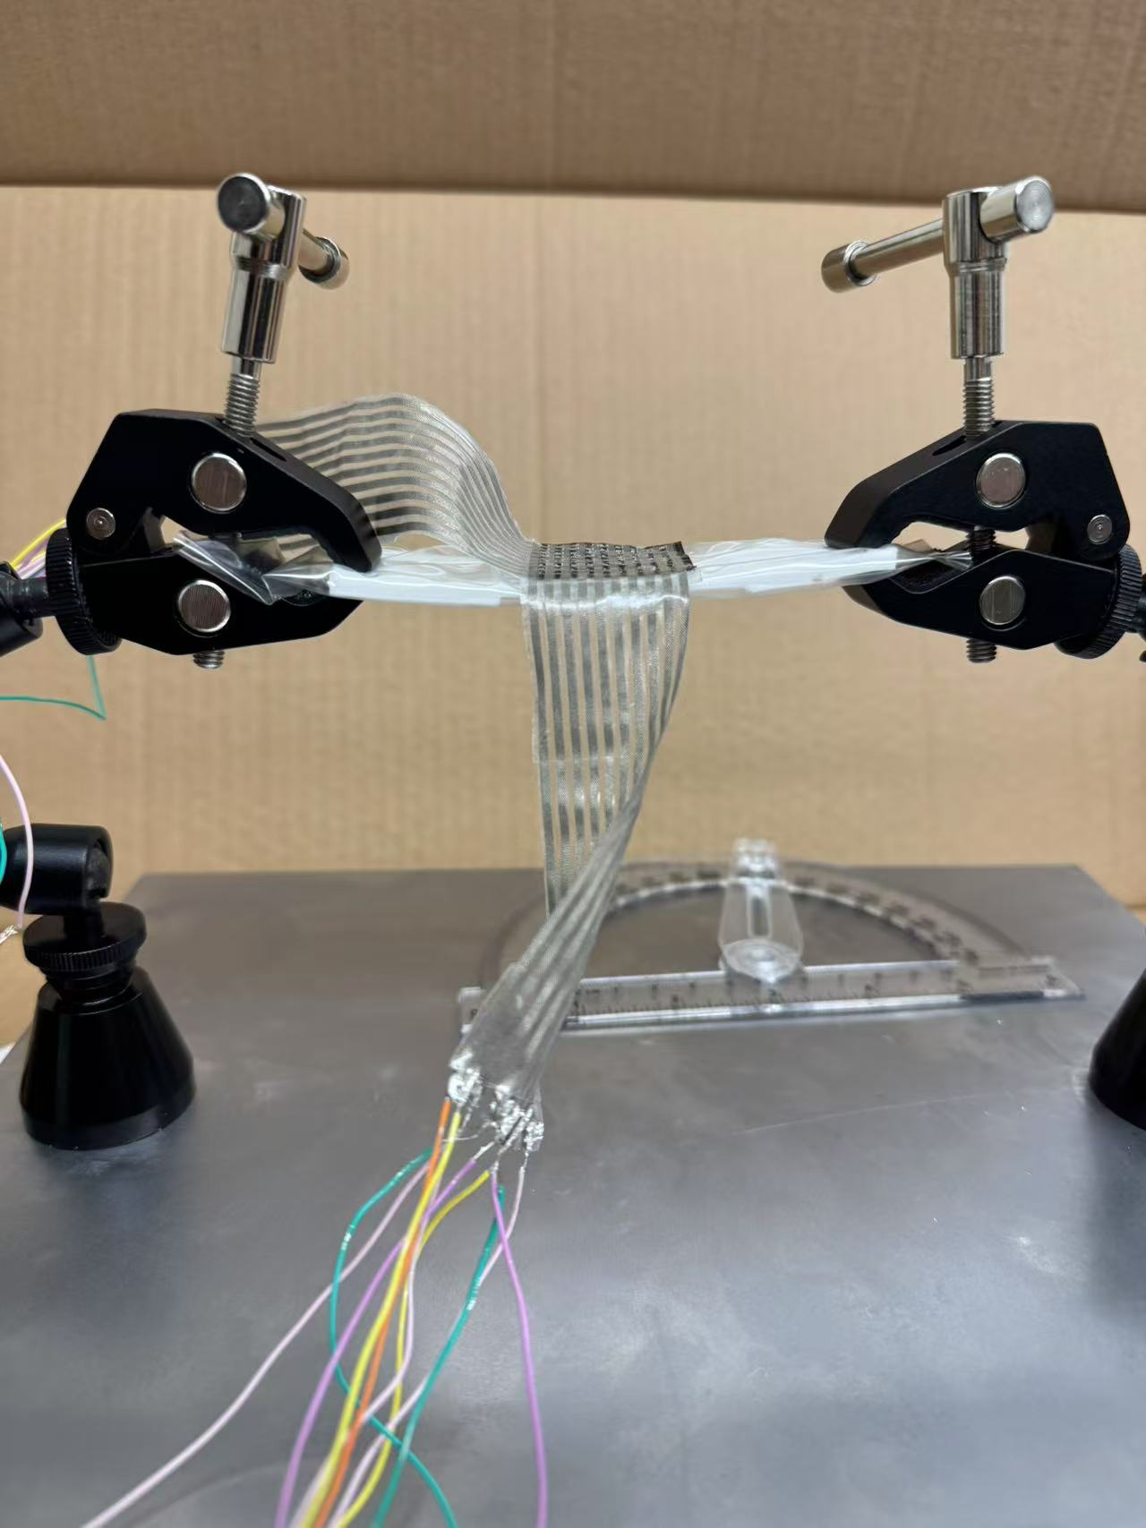
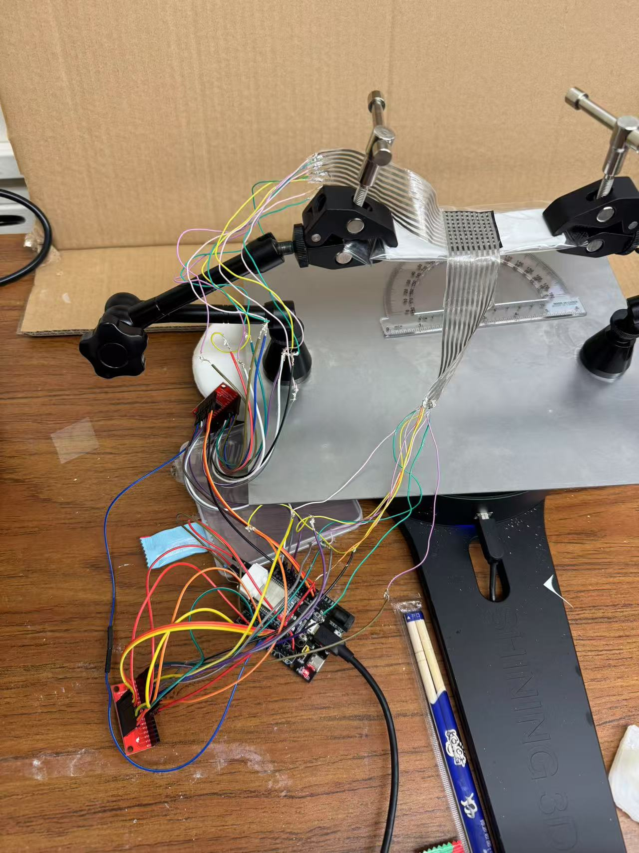
1.collect sensor data

Slide 3
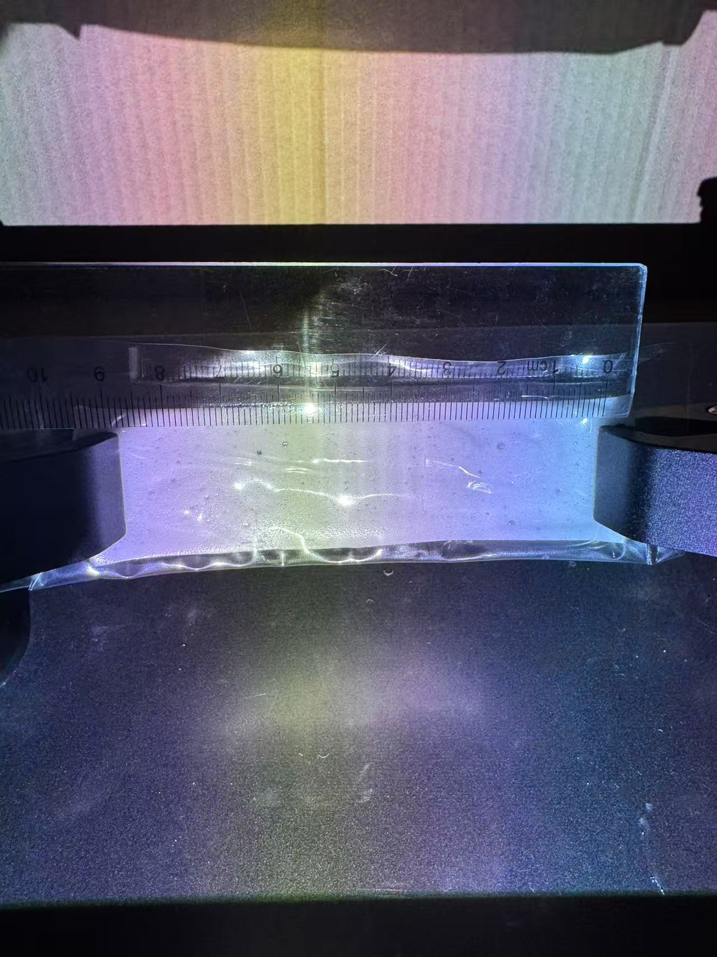
2. remove sensor and prepare to scan

Slide 4
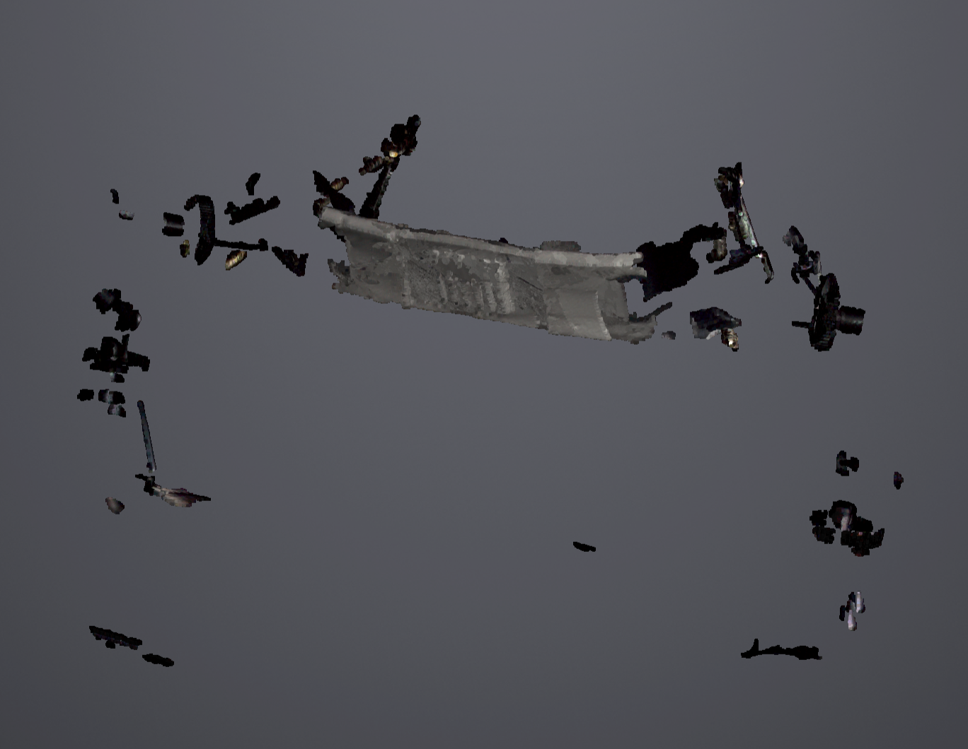
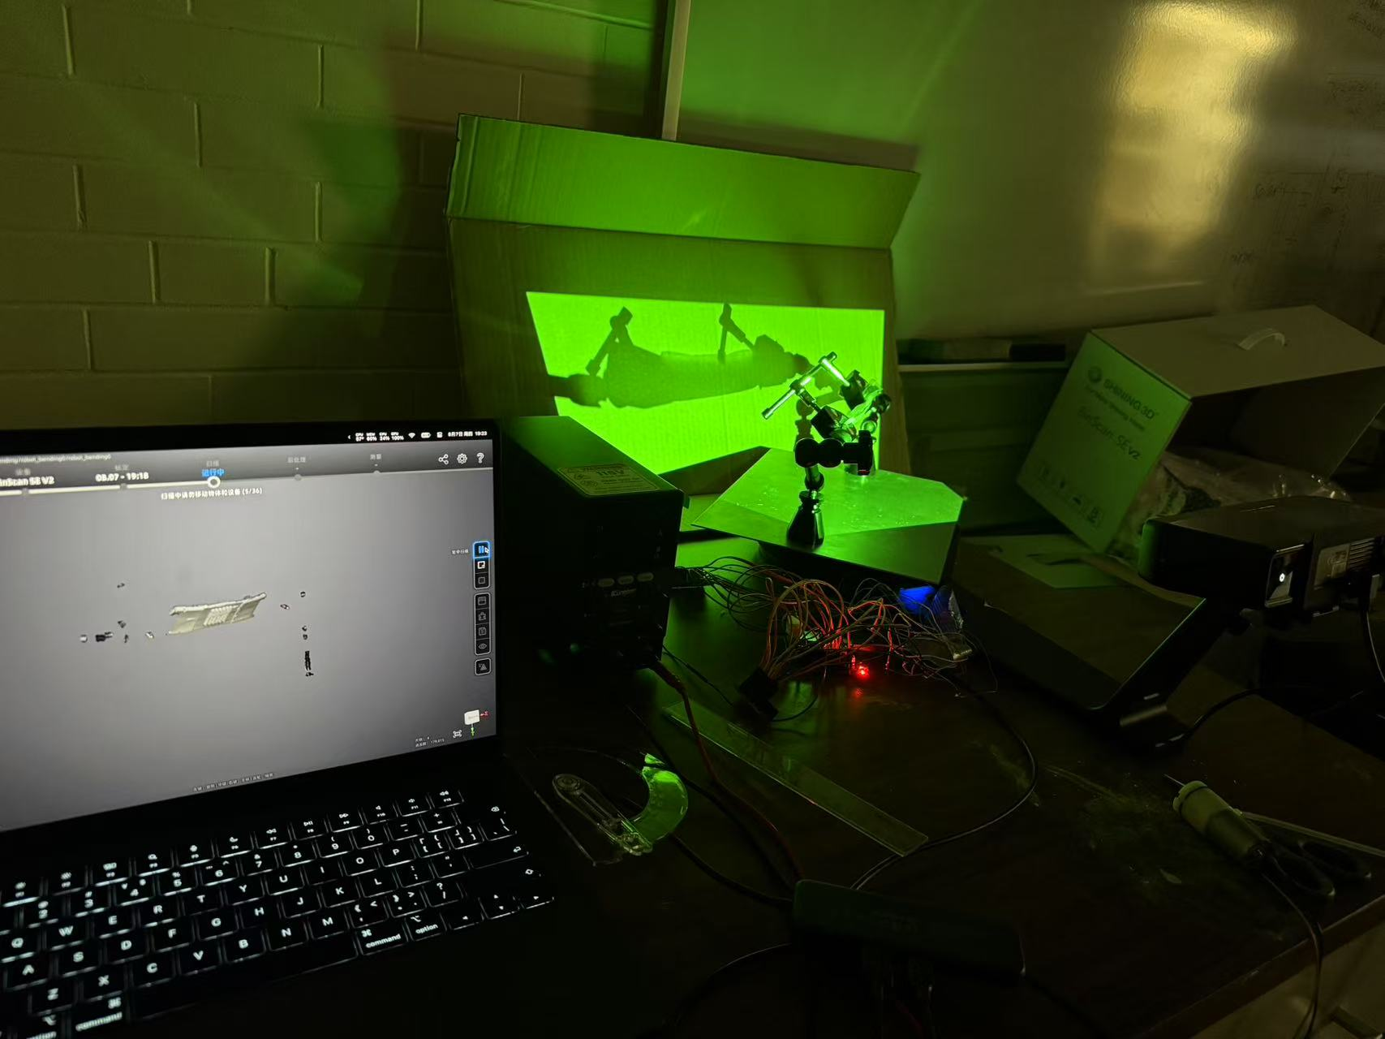
3. scan to get the model

Slide 5
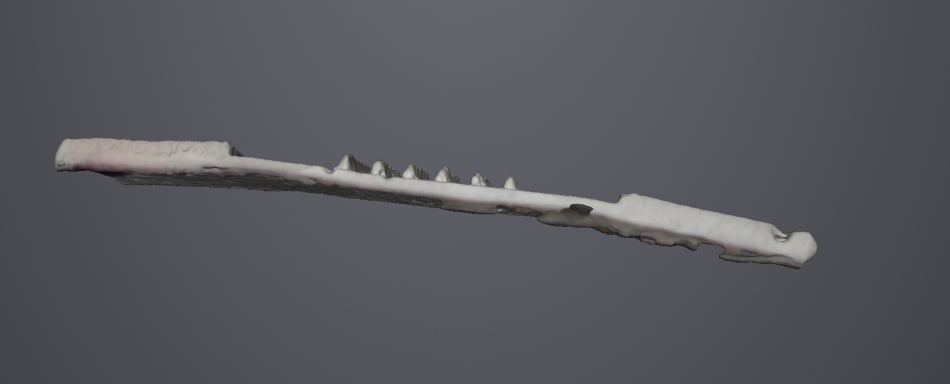
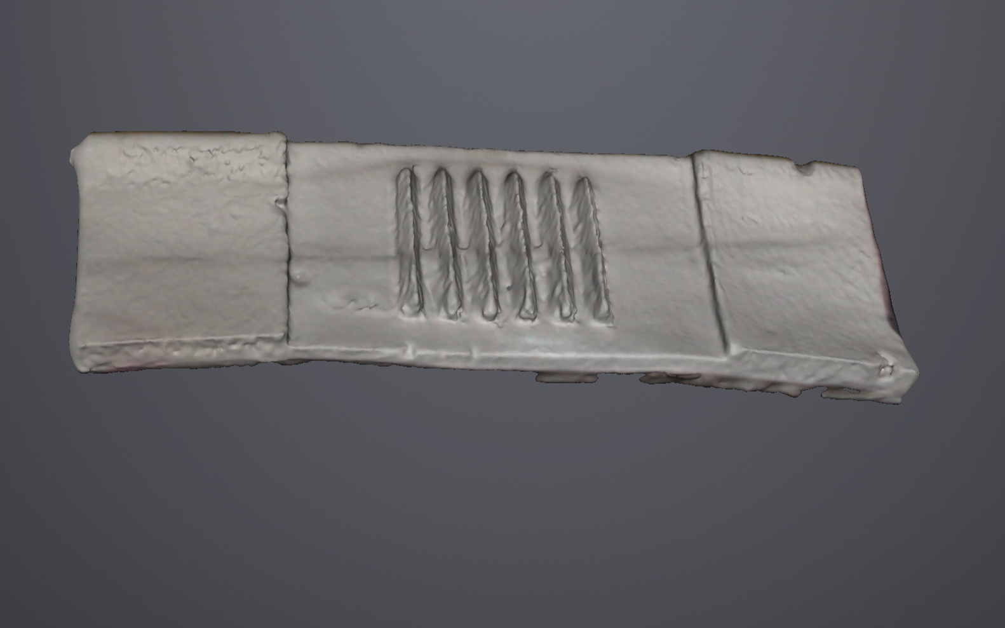
4. get the model of one frame

